Slide 1
Project Title: Bank Marketing Campaign Prediction Project (Prediction Of Bank Product Uptake )
Project Definition
Direct marketing is a form of communicating an offer, where organizations communicate directly to a pre-selected customer and supply a method for a direct response. Among practitioners, it is also known as direct response marketing. Mail, Phone calls, texting are among the most common modes used for direct marketing. These days many companies are shifting towards direct marketing campaigns due to various cost factors.
In banks, huge data records information about their customers. This data can be used to create and keep clear relationship and connection with the customers in order to target them individually for definite products or banking offers. Usually, the selected customers are contacted directly through: personal contact, telephone cellular, mail, and email or any other contacts to advertise the new product/service or give an offer, this kind of marketing is called direct marketing. In fact, direct marketing is in the main a strategy of many of the banks and insurance companies for interacting with their customers.

Slide 2
Problem Statement
A Portuguese banking institution—ran a marketing campaign to convince potential customers to invest in bank term deposit. The data is related to direct marketing campaigns of the bank.
The marketing campaigns were based on phone calls. Often, more than one contact by phone to the same client was required, in order to assess if the product (bank term deposit) would be ('yes') or not ('no') subscribed. Based on the dataset, we want to predict whether a customer will buy the product or not.
Methods

Slide 3
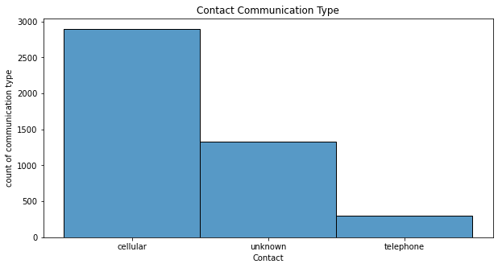
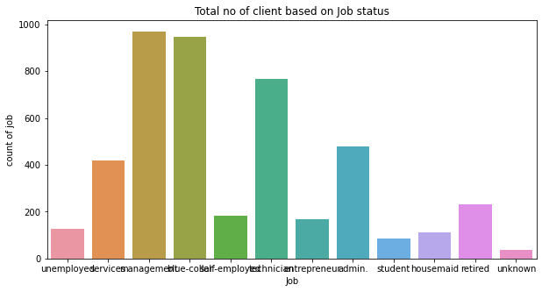
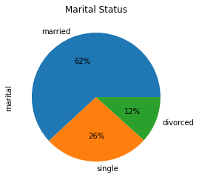
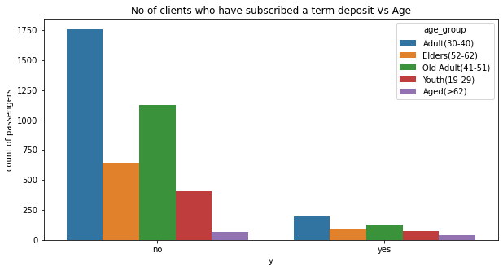
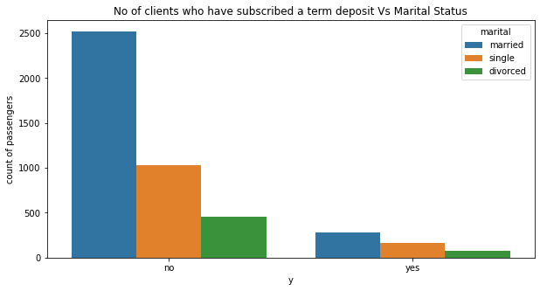
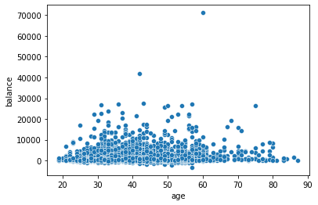

Slide 4
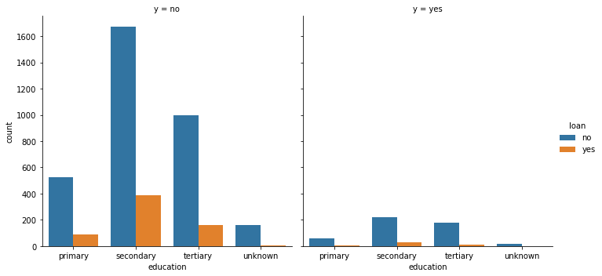
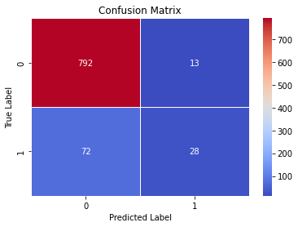
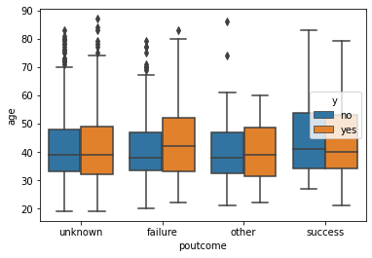
Algorithms | Accuracy | Precision | Recall
LogisticRegression | 90% | 59% | 23%
KNeighborsClassifier | 88% | 37% | 14%
DecisionTreeClassifier | 88% | 47% | 45%
RandomForestClassifier | 91% | 68% | 28%
Interpretation Of Best Model
The Random Forest Classifier model with default parameters yields 91% accuracy on training data.
Precision Score: This means that 68% of all the things we predicted came true. that is 68% of clients will subscribe to bank term deposit.
Recall Score: In all the actual positives, we only predicted 28% of it to be true.¶

